Slide 1
Designing Database Solutions for SQL Server
Christian Bolton | Technical Director, Coeo
Graeme Malcolm | Microsoft

Slide 2
Course Topics
Designing Database Solutions for SQL Server
01 | Managing a SQL Server Environment
02 | Designing Database Security
03 | Designing a Backup & Recovery Solution
04 | Designing a High-Availability Solution
05 | Troubleshooting & Maintaining a database

Slide 3
03 | Designing a Backup & Recovery Solution
Christian Bolton | Technical Director, Coeo
Graeme Malcolm | Microsoft

Slide 4
Module Overview
Backup & Recovery Strategies
Backing up to Azure Blob Storage
Advanced Restore Scenarios

Slide 5
Recovery Models
Recovery Model | Description
Simple | Does not permit or require log backups Automatically truncates log to keep space requirements small
Full | Requires log backups for manageability Avoids data loss due to a damaged or missing data file Permits recovery to a specified point in time
Bulk Logged | Requires log backups for manageability Can enhance the performance of bulk copy operations Reduces log space usage by using minimal logging for many bulk operations

Slide 6
Backup Types
Backup type | Description
Full | All data files and the active part of the transaction log
Differential | The parts of the database that have changed since the last full database backup
Transaction Log | Any database changes recorded in the log files
File/File Group | Specified files or filegroups
Partial | The primary filegroup, every read/write filegroup, and any specified read-only filegroups
Tail-log Backup | Log backup taken of the tail of the log just before a restore operation
Copy Only | The database or log (without affecting the backup sequence)

Slide 7
Determine Recovery Objectives
What is the maximum time it can take to recover?
Recovery Time Objective (RTO)
How much data can you afford to lose?
Recovery Point Objective (RPO)
Backup strategy should map to requirements
Types and frequency
Media
Retention period
Testing

Slide 8



Full Database Backup Strategies
Sunday
Monday
Tuesday
Full database backups
Back up all data
Can be used to restore he whole database
Recovery to backup times only

Slide 9
Transaction Log Backup Strategies
Sunday
Monday
A database and transaction log backup strategy
Involves full and transaction log backups
Enables point in time recovery
Allows the database to be fully restored

Slide 10




Differential Backup Strategies
Monday
Tuesday
A differential backup strategy
Full and differential database backups
Includes differential backups with only changed data

Slide 11

Partial Backup Strategies
Monday
Tuesday
Wednesday
Thursday
Friday
Faster backup and restore for very large databases
Can be complex to set up an manage

Slide 12
Options for Ensuring Backup Integrity
Mirrored Media Sets
Enterprise only
CHECKSUM backup option
All backup types
Generates a checksum which can be checked for integrity
Used to verify the backup
Backup verification
Can use RESTORE VERIFYONLY for backup verification
Useful when combined with the CHECKSUM option

Slide 13
Backing up to Microsoft Azure
Backup to URL is now a feature
Provides offsite near-bottomless storage
Geo-redundant capable
Encrypted backups allow you to have backups compressed and encrypted
Restore to on-premises or to Microsoft Azure

Slide 14
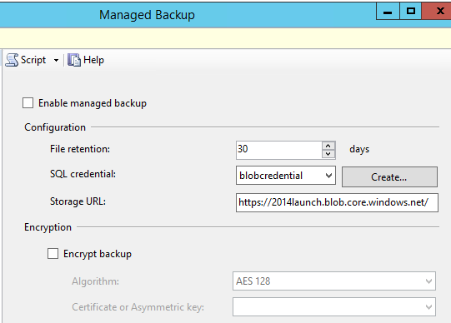
Managed Backups to Azure
Automated SQL Server backups to Azure
New for SQL Server 2014
Specify retention period from 1 to 30 days
Full backups weekly or 1GB+ log use
Transaction log backups every 2 hours or 5MB+ use

Slide 15
Backup to Azure

Slide 16
Advanced Restore Scenarios
Restoring an encrypted backup to a new server
Create a database master key for the master database
Create the encryption certificate or key from a backup
Restore the database

Slide 17
Restoring an encrypted backup

Slide 18
Advanced Restore Scenarios
Recovering from damaged databases
Don’t forget to take a tail-log backup to minimise data loss
Log records can be cached when the transaction log is damaged
A valid transaction log can still be backed up when the data file is damaged

Slide 19
Data recovery with tail-log backups

Slide 20
Designing a Backup and Recovery Solution
Summary
Backup & Recovery Strategies
Backing up to Azure Blob Storage
Advanced Restore Scenarios

